Slide 1

Cache Memory
Presented By:
Sourabh Nagpal
Subhajit Das
Kalpana Choudhary

Slide 2
Contents
Introduction of Cache
Cache architecture
Operations
Memory Hierarchy
Replacement techniques
Cache Mapping
Block Replacement Techniques
Advantages

Slide 3

Cache
Cache memory is a small, high-speed storage area located within or near the CPU (Central Processing Unit) of a computer. It stores frequently accessed data and instructions that the CPU is likely to reuse. The purpose of cache memory is to speed up the processing by reducing the time it takes for the CPU to access data from the main memory (RAM), which is slower compared to cache.
Cache hit ratio:
It measures how effectively the cache fulfills the request for getting content.
Cache hit ratio = $\frac{\text{No} \text{of} \text{cache} \text{hits}}{\text{(}\text{No} \text{of} \text{cache} \text{hits}\text{ + }\text{No}\text{. }\text{of} \text{cache} \text{Miss}\text{) }}$
If data has been found in the cache, it is a cache hit else a cache miss.

Slide 4
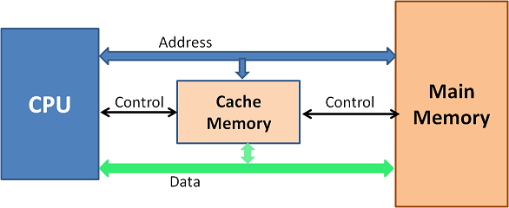
ARCHITECTURE

Slide 5
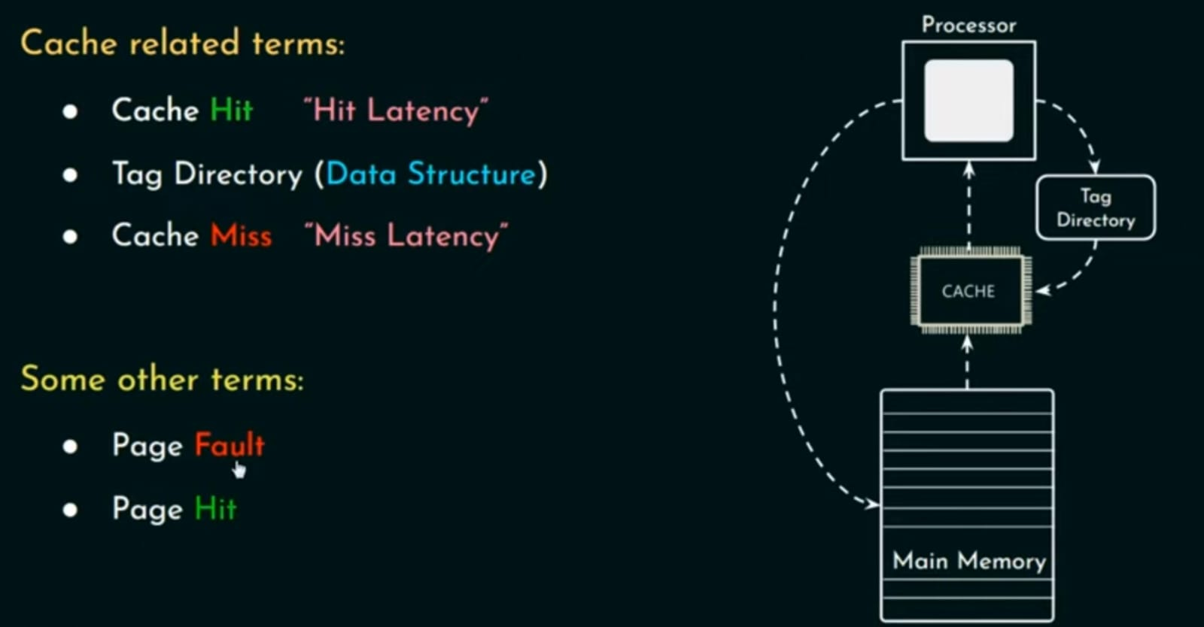
OPERATIONS

Slide 6
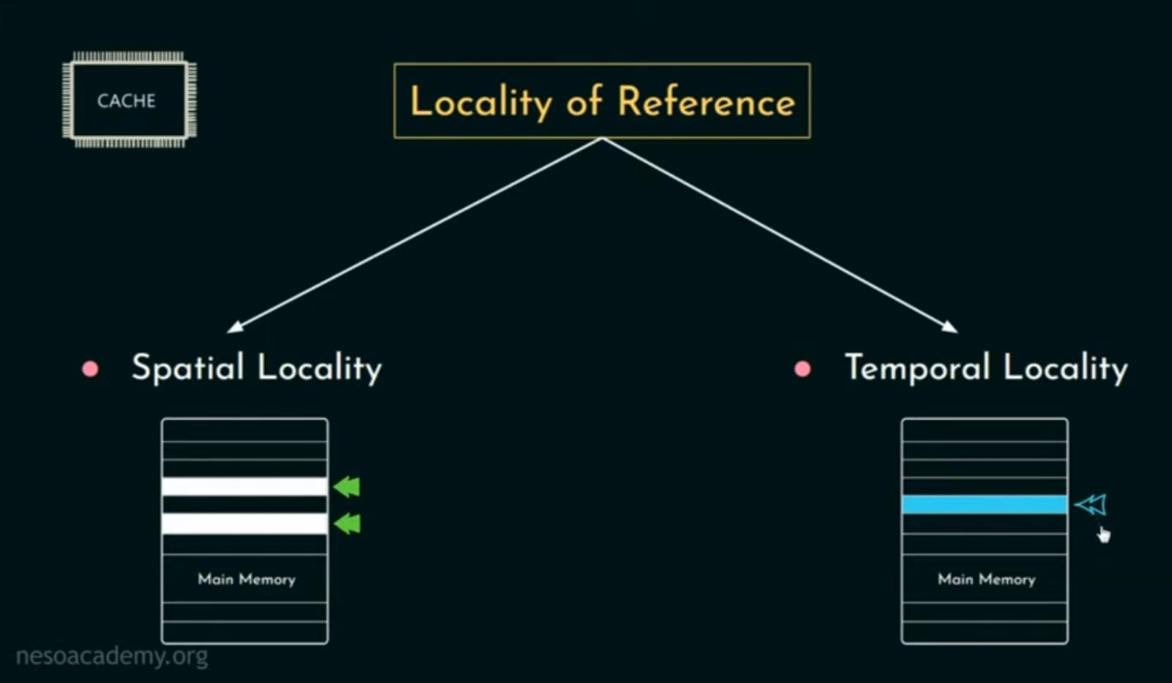
CONT…..

Slide 7
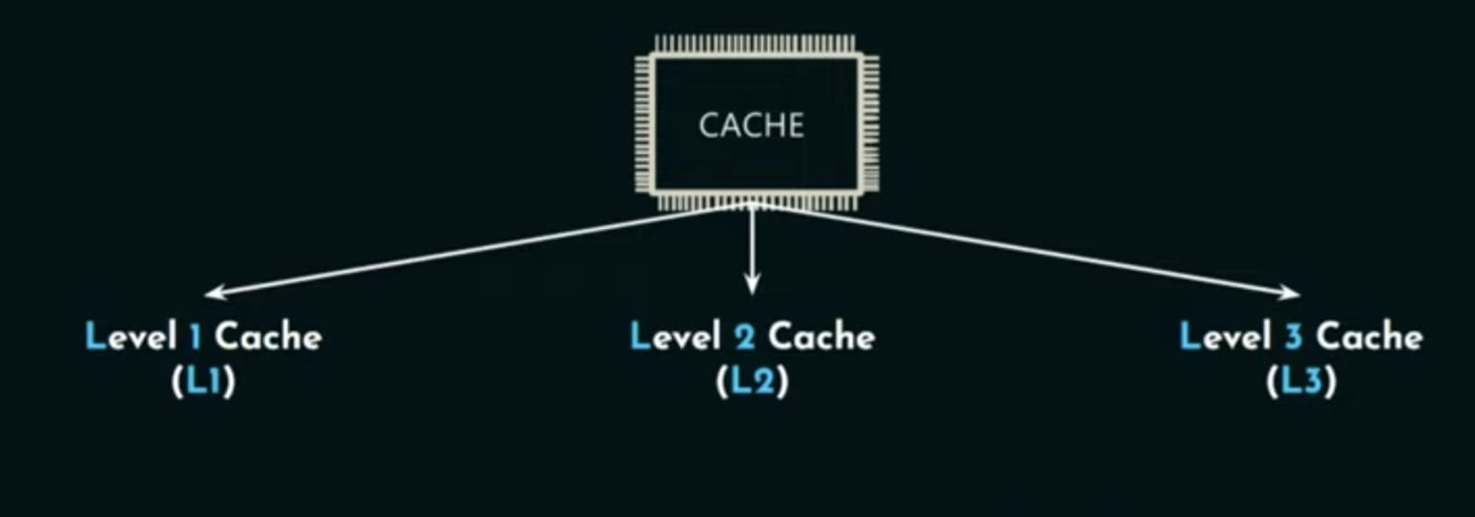
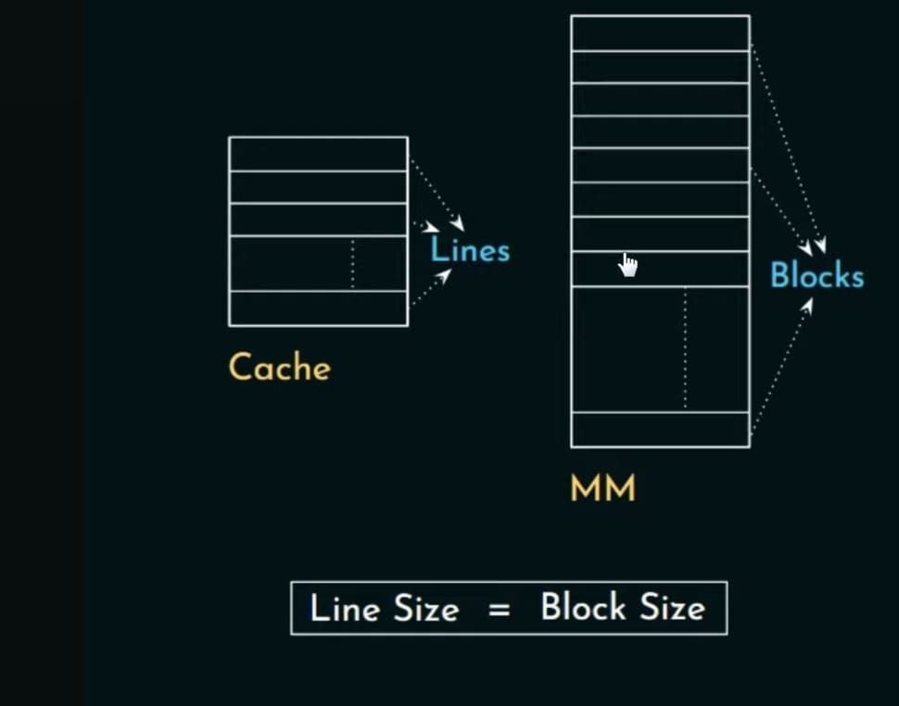
CONT…..

Slide 8
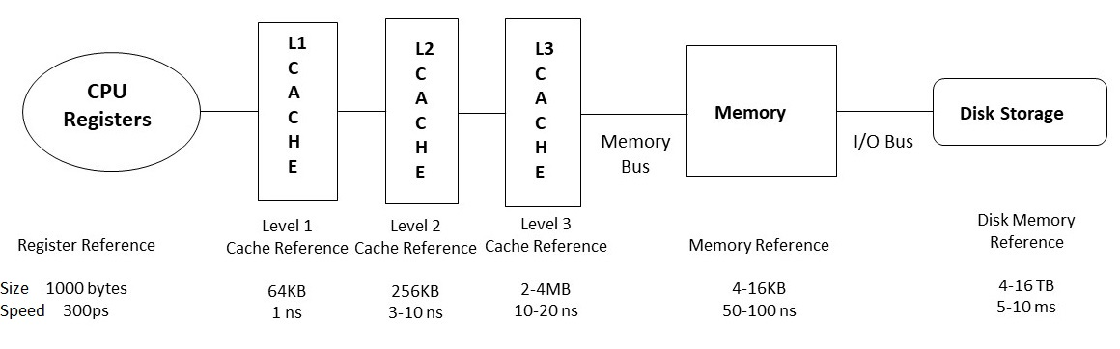
MEMORY HIERARCHY

Slide 9
CONT…..
CPU Registers
Registers are small, high-speed memory units located in the CPU. They are used to store the most frequently used data and instructions. Registers have the fastest access time and the smallest storage capacity, typically ranging from 16 to 64 bits.

Slide 10
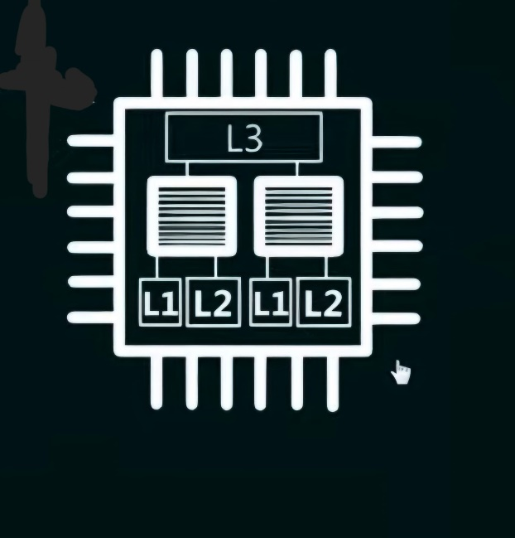
CONT…..
CACHE MEMORY LEVELS
There are three levels of cache memory
L1 Cache:This is the smallest and fastest type of cache memory. It is integrated directly into the CPU chip and stores data that is immediately needed by the processor.
L2 Cache: Slightly larger and slower than L1 cache, L2 cache is often located on the CPU chip can also be found near the CPU. It stores data that may be needed in the near future but isn’t as time-sensitive as L1 cache.
L3 Cache: This is the largest and slowest of the three, typically shared by multiple cores in a multi-core processor. It holds data that is less immediately needed but can still speed up processing.

Slide 11
CONT…..
Main Memory
Main memory, also known as RAM (Random Access Memory), is the primary memory of a computer system. It has a larger storage capacity than cache memory, but it is slower. Main memory is used to store data and instructions that are currently in use by the CPU.
Secondary Storage
Hard disk drive(HDD) and solid-state drives (SSD) is a non-volatile memory unit that has a larger storage capacity than main memory. It is used to store data and instructions that are not currently in use by the CPU. Secondary storage has the slowest access time and is typically the least expensive type of memory in the memory hierarchy.

Slide 12
CACHE MAPPING
Cache mapping refers to the method used to store data from main memory into the cache. It determines how data from memory is mapped to specific locations in the cache.
There are three different types of mapping used for the purpose of cache memory which is as follows:
Direct Mapping
Fully Associative Mapping
Set-Associative Mapping

Slide 13
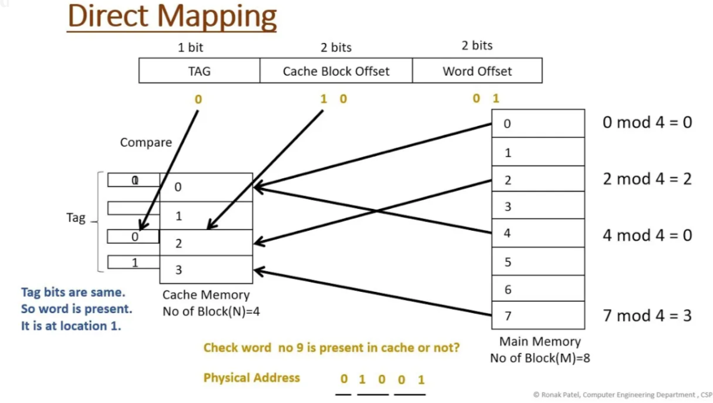
DIRECT MAPPING
Each block from main memory has only one possible place in the cache organization in this technique

Slide 14
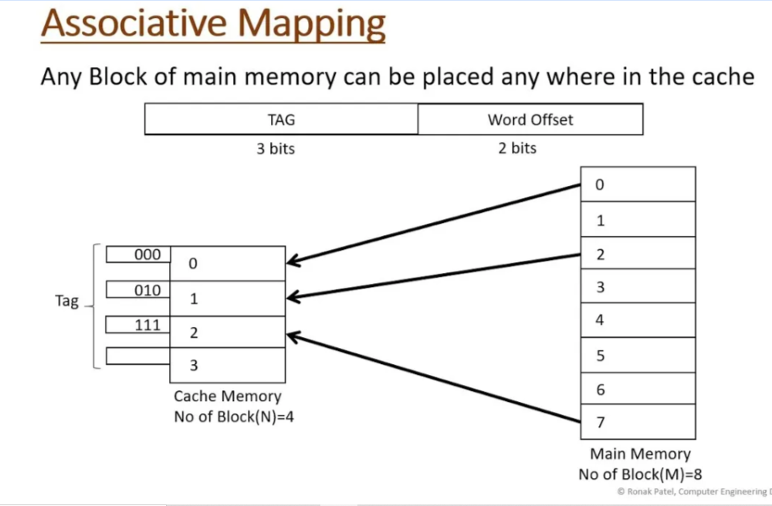
ASSOCIATIVE MAPPING
In the associate mapping of the main memory block can be done with any of the cache block. This technique is called as fully associative cache mapping. The memory address has only 2 fields
Word
tag.

Slide 15
SET ASSOCIATIVE MAPPING
Compromise that exhibits the strengths of both the direct and associative approaches while reducing their disadvantages.
Cache consists of a number of sets.
Each set contains a number of lines.
A given block maps to any line in a given set.
e.g. 2 lines per set.
2 way associative mapping.
A given block can be in one of 2 lines in only one set.

Slide 16
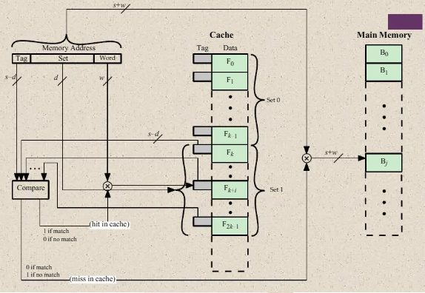
K-WAY SET ASSOCIATIVE CACHE

Slide 17
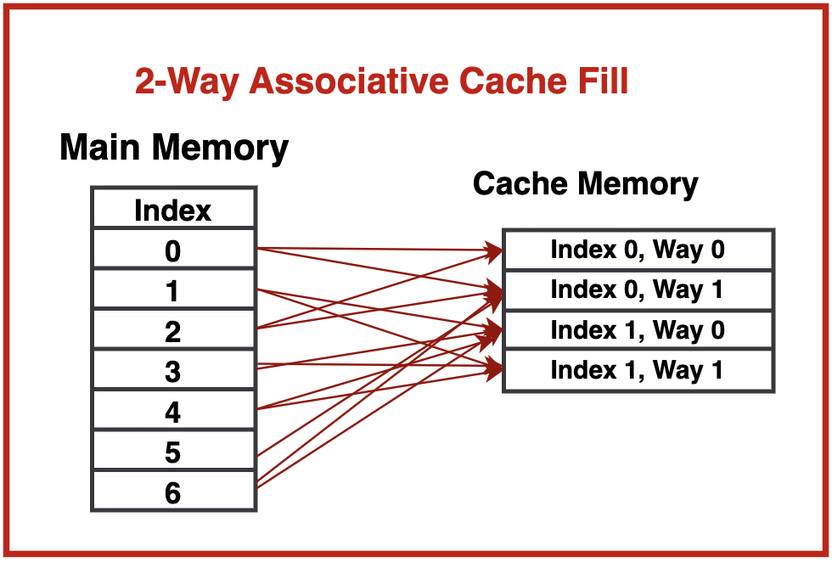
2-WAY SET ASSOCIATIVE CACHE

Slide 18
BLOCK REPLACEMENT TECHNIQUES
Random
First-In-First-Out (FIFO)
Last-In-First-Out (LIFO)
Least Recently Used (LRU)
Pseudo-LRU (PLRU)
Not Recently Used (NRU)
Least Frequently Used (LFU)
Re-Reference Interval Prediction (RRIP)
Optimal

Slide 19
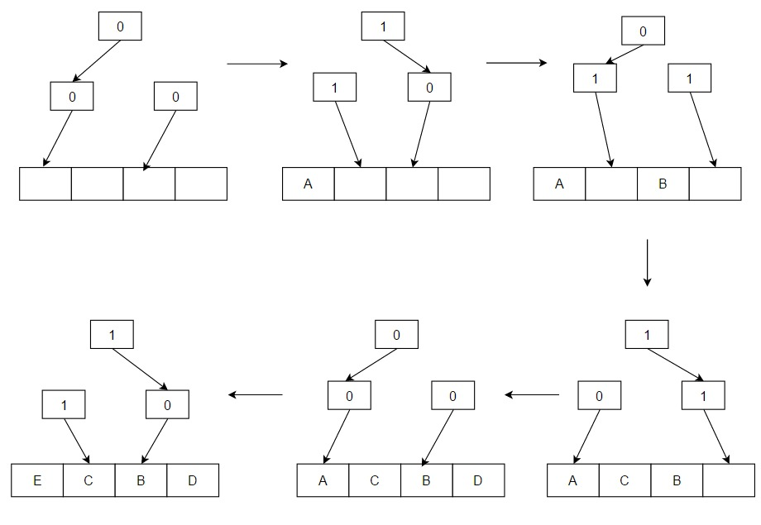
PSEUDO-LRU (PLRU)
Binary tree encodes PLRU partial order
At every level point to LRU half of subtree
Each access: Flip nodes along path to block
Eviction: Follow LRU path
Overhead: (a-1)/a bits per block

Slide 20
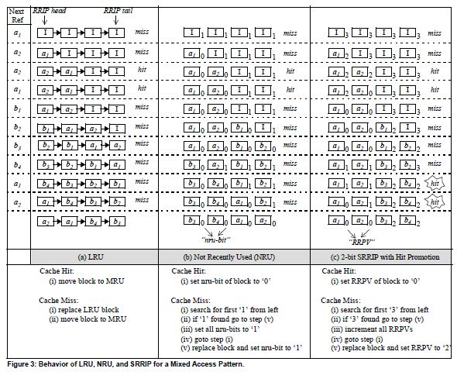
RE-REFERENCE INTERVAL PREDICTION (RRIP)

Slide 21
Cache Access
Read Operations
Write Operations
Read Miss
Write Hit
Read Hit
Write Hit
Write Miss
Write Miss

Slide 22
Read Operation
Read Hit: When the CPU requests data and the cache already has it stored, this is considered a “Read Hit”.
Read Miss: When the CPU requests data and the cache does not have it, this is a “Read Miss”.
Cache memory
000
001
010
011
100
101
110
111
Song1
File.sv
Song 2
notes
Pdf files
design
design
File2.v
Request | Rd hit/miss
0011 | hit
0100 | hit
1000 | miss
0001 | hit
CPU
Request

Slide 23
Write Operation
The information is written to both the block in the cache and to the main memory.
The information is written only to the block in the cache. The modified cache block is written to main memory only when it's replaced.
The block is loaded into cache on a write miss.
Used along with write back caches
The block is modified in the main memory but not in cache.
Used along with write-through caches.
Write Through
Write Hit
Write Back
Write Allocate
Write Miss
No-Write Allocate

Slide 24
Write through Cache with - No Write Allocation
Memory Request
Request
type
Read
write
Cache hit ?
Yes
Cache hit ?
Yes
No
No
Locate a cache block to use
Write data into cache block
Read data from lower memory into the cache block
Write data into cache block
Return Data
Write data into lower memory
Done

Slide 25
Memory Request
Read
Request
type
Write
Cache hit ?
Yes
Cache hit ?
No
Yes
No
Locate a cache block to use
Locate a cache block to use
Is it dirty ?
Yes
Is it dirty ?
Yes
No
Write its previous data back to the lower memory
No
Write its previous data back to the lower memory
Read data from lower memory into the cache block
Mark the cache block as not dirty
Read data from lower memory into the cache block
Return Data
Write the new data into the cache block
Mark the Cache block as dirty
Done

Slide 26
ADVANTAGES
Faster Data Access
Reducing Latency
Improving CPU Performance
Storing Frequently Accessed Instructions
Handling Memory Bottlenecks
Optimizing Multitasking
Efficiency in Repetitive Tasks

Slide 27
Test Case | Description | Expected Outcome
Reset =1 | Reset the cache memory | Every location of cache must be vacant
Cache Hit (Read) | Read request is made for an address that is already in the cache. | Data is fetched from the cache, cache_hit=1, and data_out=expected_value.
Cache Miss (Read) | Read request for an address not present in the cache. | cache_miss=1, fetch data from memory, update cache, return data.
Cache Hit (Write) | Write request for an address present in the cache. | Data is updated in cache, cache_hit=1, behavior depends on write policy.
Cache Miss (Write) | Write request for an address not present in cache. | Behavior depends on No-Write Allocation vs. Write Allocation.

Slide 28
Test Case | Description | Expected Outcome
Cache Hit with Different Addresses | Read requests are issued for multiple addresses, all of which are in the cache. | Each address returns correct data with cache_hit=1.
Dirty Block Check | write data on cache | dirty bit should become 1 after writing the data in cache.
Performance Check | Check Hit vs Miss Ratio | Hit Ratio should be more as compare to Miss Ratio
Least Recently Used(LRU) Check | Whether the replacement is being done correctly or not | Replacement is done as per LRU.

Slide 29
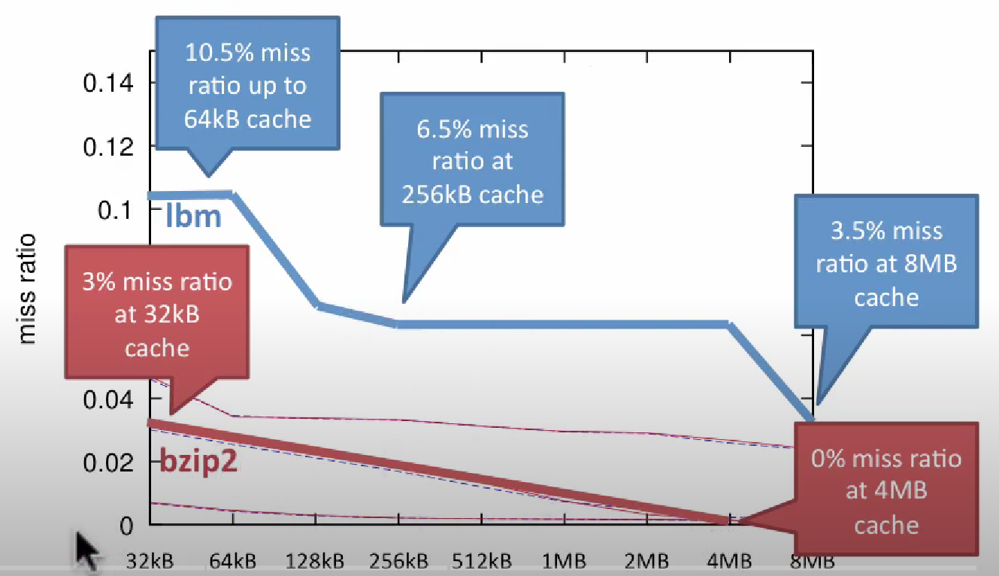
Observation of Hit & Miss in 2 different size of cache
You can consider lbm and bzip are apps in our mobile phone

Slide 30
Consider a fully associative cache with 8 cache blocks(0-7) and the following sequence of memory block requests: 4,3,25,8,19,6,25,8,16,35,45,22,8,3,16,25,7 if LEU replacement policy is used, which cache block will have memory block 7?

Slide 31
Thank YOU

